Slide 1

DATA Processing/ Transformation

Slide 2





Independent vs dependent features/variables
Features:
In any dataset we can distinguish between two types of features/variables/columns:
Independent / predictive ( those that we will use to make predictions )
Dependent / Target ( WHAT want we want to predict USING the INDEPENDENT FEATURES )

Slide 3


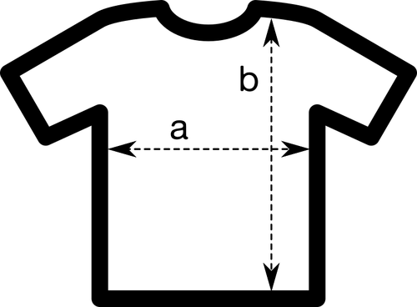
Types of features
Features:
There are always two types of features or variables:
Numerical: (numbers: 1, 2, 3…,3.15, 38.4)
Categorical (tags)
Ordinal ( they display some kind of order )
Nominal (they don’t have any order
Dates:
Usually we use date differences.
How we can distinguish between them?
Numericals express an amount (they can be added, subtracted, multiplied, divided..)
Categoricals doesn’t express an amount, express a tag.

Slide 4
Value Types found on datasets
Value types:
We can find any combination of features in a dataset:
Numerical:
Integers
Float numbers
Categorical (tags )
Characters (“a”, “b”, “W”,....)
Strings (“My car is red”, “Yahoo!”, “englishhh”,...)
Booleans ( True / False, Yes / Not)
0

Slide 5


Garbage in / Garbage out
Value types:
A model prediction will never be better than your input data!

Slide 6
Data cleaning / wrangling
Standardize column names
Deleting and rearranging columns
Working with data types (set the correct type)
Filtering data
Removing duplicates
Collecting typos
Conditional formatting
Replace missing values
00

Slide 7
Dealing with missing values
Drop rows
Drop them
Drop columns
NA’s
Custom replacement
Replace them
Imputation methods

Slide 8

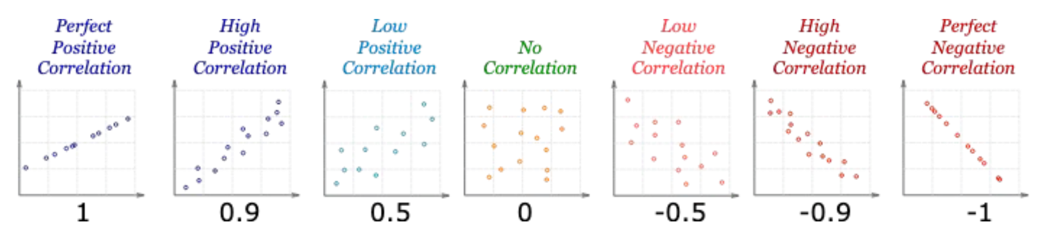
IRONHACK BOOTCAMP
Checking for Correlation
The correlations quantifies how much linearly related are two numerical variables.
The correlation coefficient can be positive, negative or null
The range of values is: -1, 1
Correlation doesn’t imply causation

Slide 9
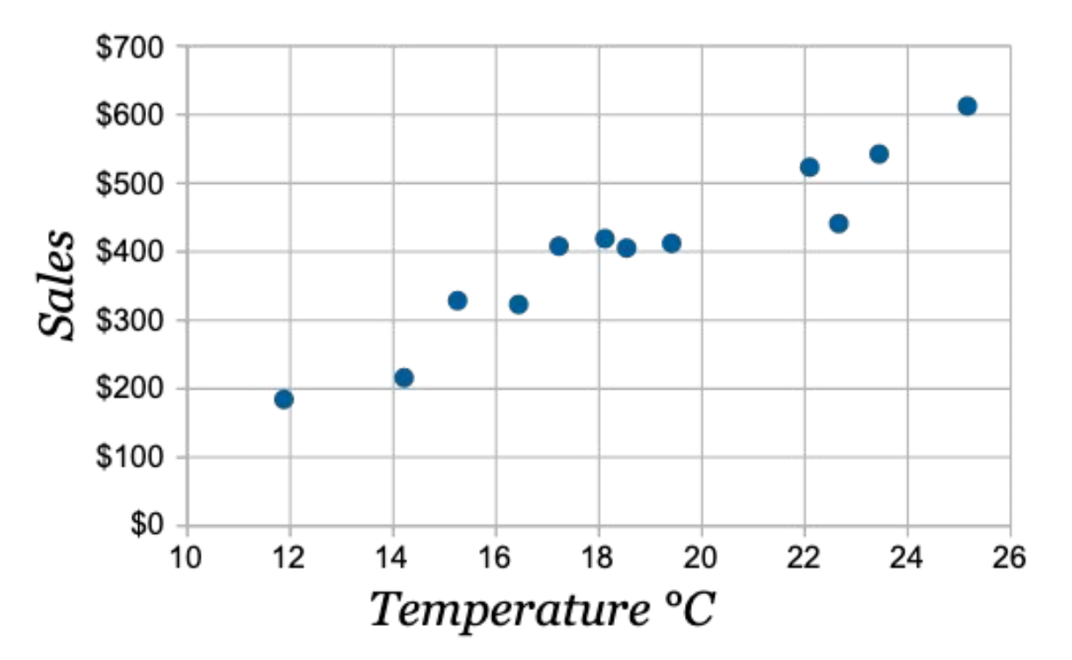
IRONHACK BOOTCAMP
LINEAR CORRELATION EXAMPLE

Slide 10
IRONHACK BOOTCAMP
TRANSFORMING DATA: TRANSFORMERS
Collected data can be affected by:
Outliers
Small range
Skewness
All those problems will affect the predictive power of your model
You will need to transform the data to:
Improve interpretability
Declutter graphs
Discover relationships between variables

Slide 11
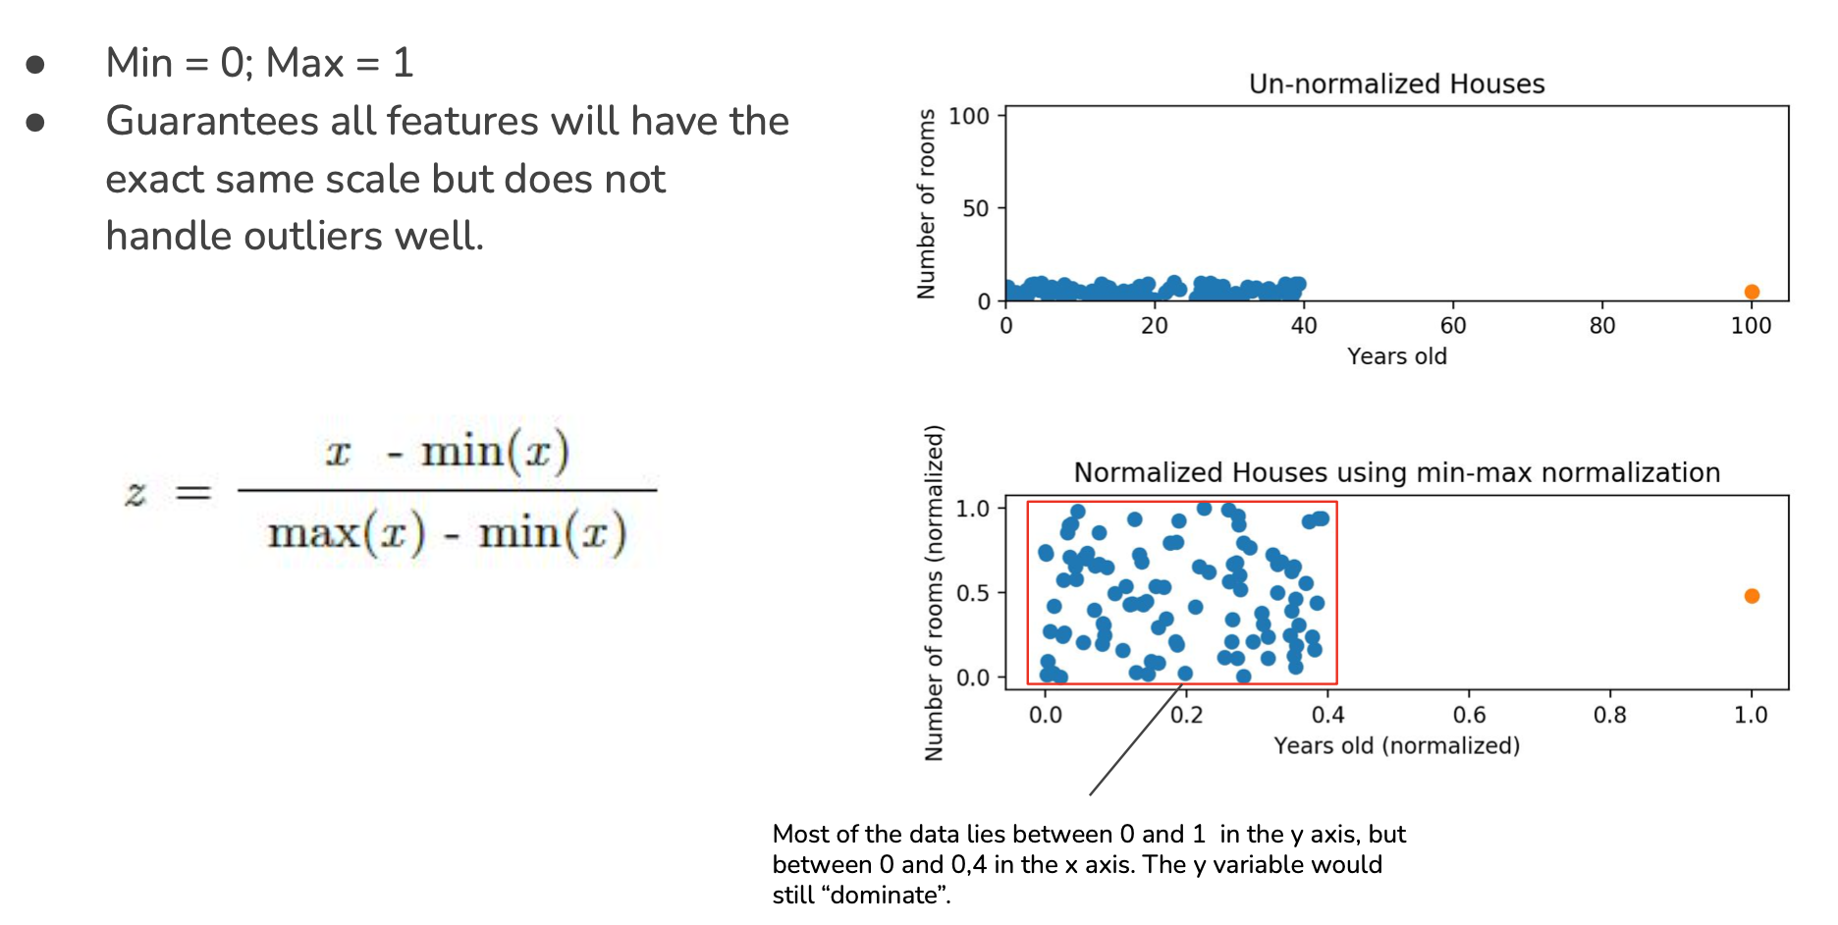
IRONHACK BOOTCAMP
MIN-MAX TRANSFORMER:
MinMaxScaler

Slide 12
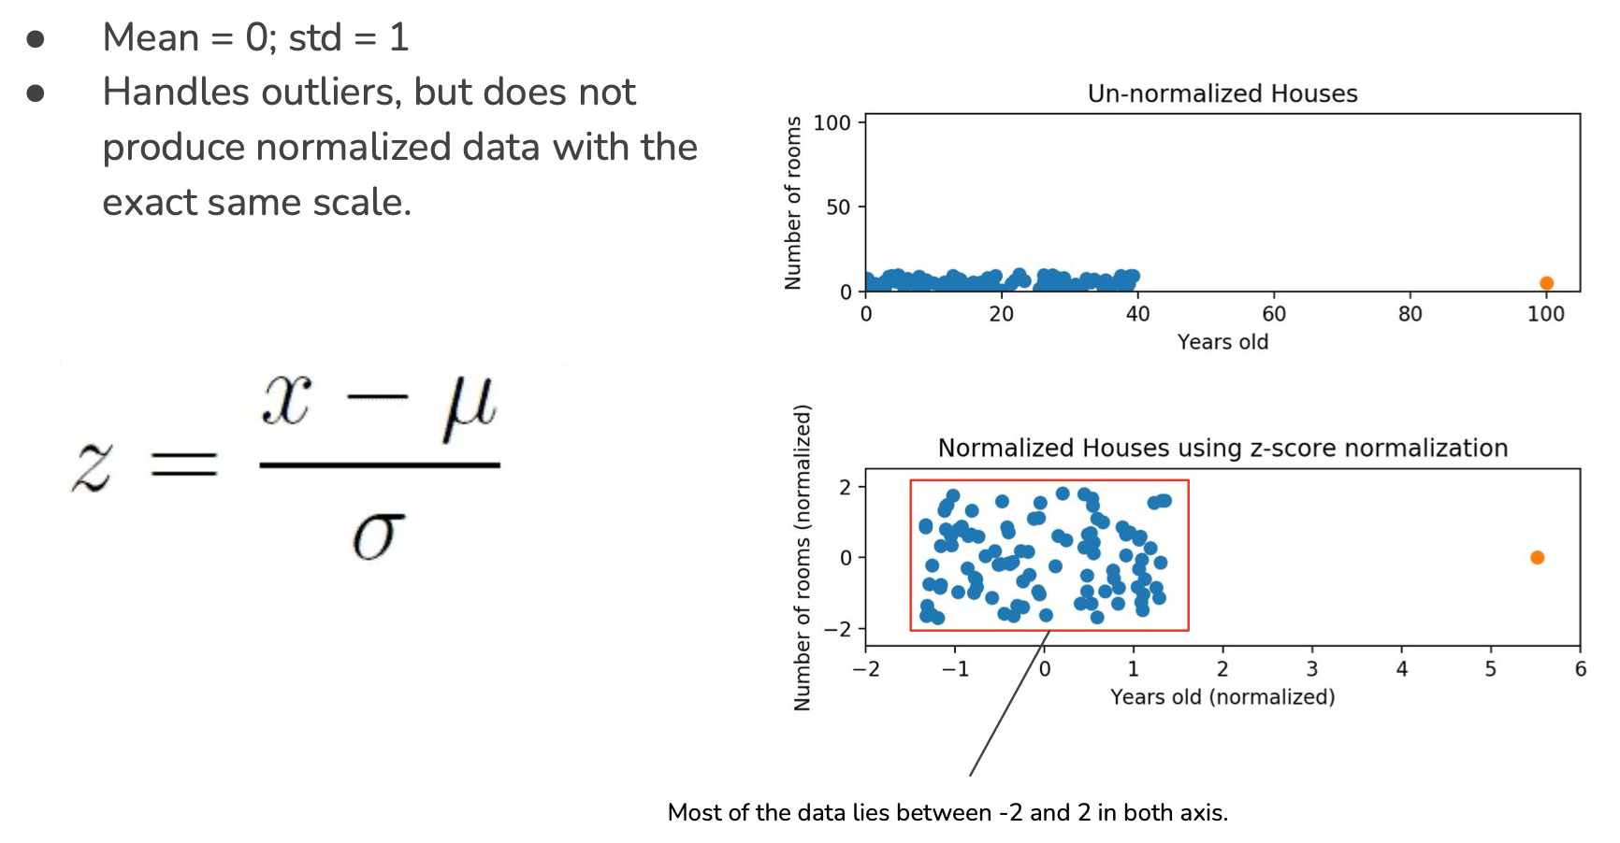
IRONHACK BOOTCAMP
STANDARDSCALER TRANSFORMER:
StandardScaler

Slide 13
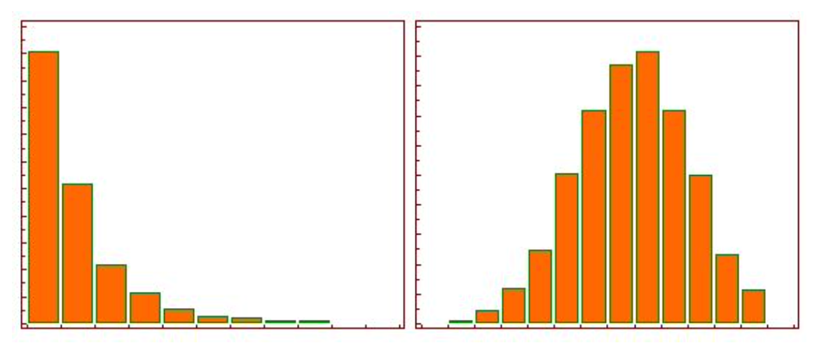
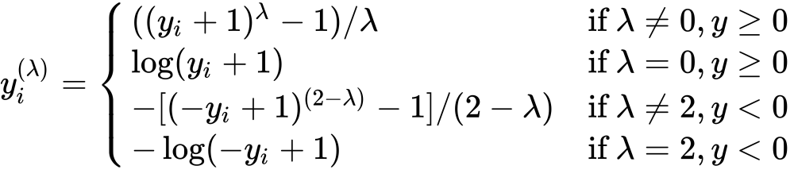
IRONHACK BOOTCAMP
POWER TRANSFORMER:
PowerTransformer
Replaces the values in each column in order to end up with a new distribution with the smallest skewness.
Depends on a parameter called “lambda” to be determined for each sample.

Slide 14

Encoding data
Numerical
Features
Nominals
One Hot Encoding
Categoricals
Ordinals encoding
Ordinals

Slide 15
One Hot Encoding
Consists in getting an dataframe of binary entries for each value of the categorical column.
Color
Red
Green
Blue
Red | Green | Blue
1 | 0 | 0
0 | 1 | 0
0 | 0 | 1
Pros: Easy to automate. Cons: Increases the number of columns

Slide 16
Ordinal Encoding
Consists in assigning numerical values to each unique value of the categorical column according to an “implicit” relative ordering
Educational level | Value
Analphabet | 0
Primary School | 1
High School | 2
Bsc | 3
Ph.D. | 4

